Slide 1

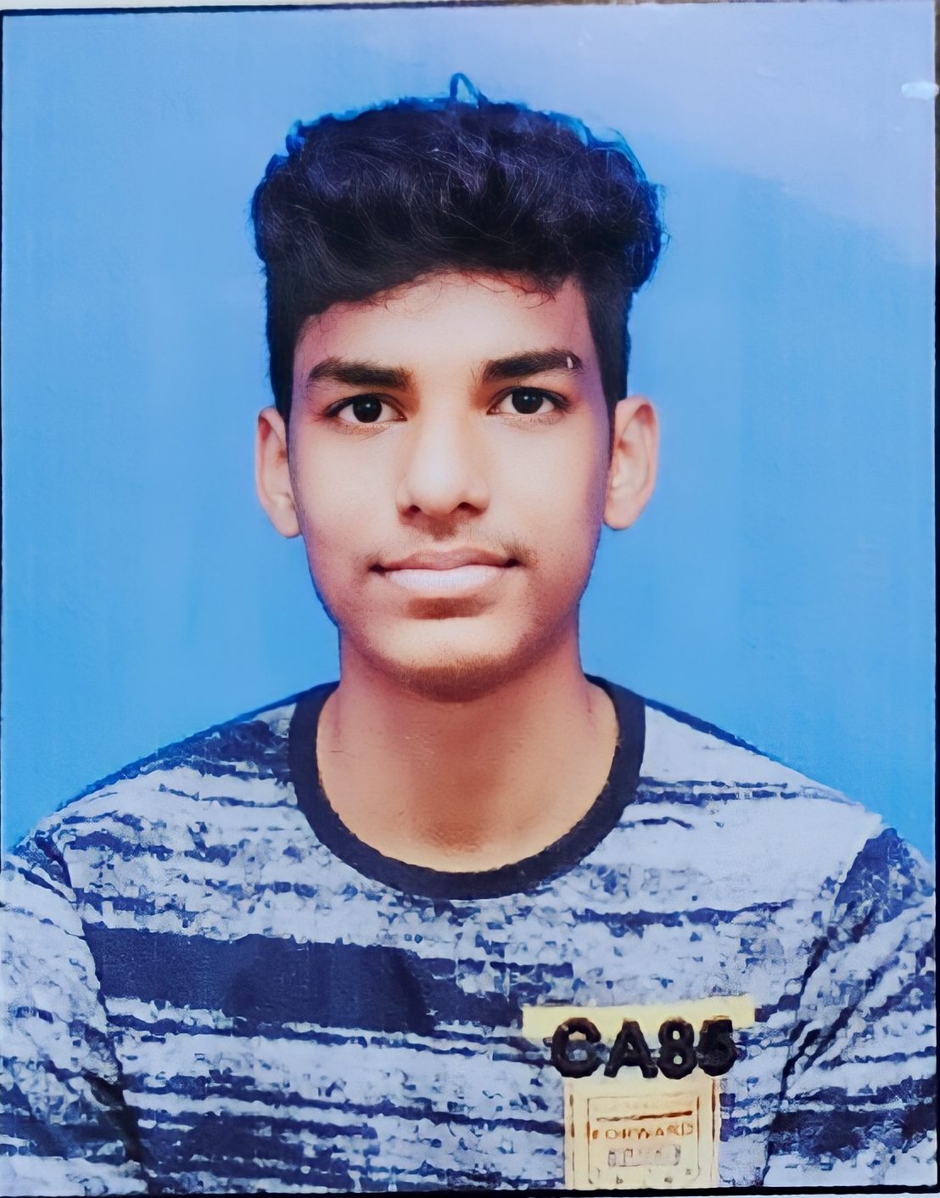
*INTRODUCTION*
NAME : LAVEEN
RESISTRATION NUMBER: 12211491
FROM: ANDHRA PRADESH(vizag)
COURSE : COMPUTER SCIENCE(CSE)
UNIVERSITY: LOVELY PROFESSIONAL UNIVERSITY

Slide 2
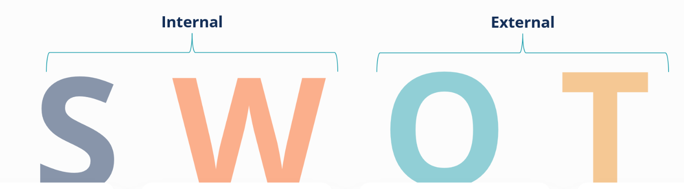

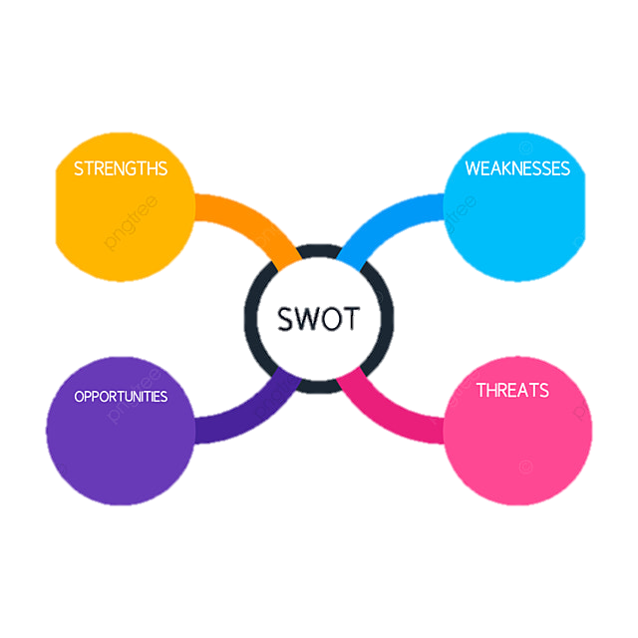

SWOT

Slide 3

software
:
System programme
engineering
:
Developing products, well defined
principles,
Methods & procedure
y
Software engineering is the application of principles used in the field of engineering, which usually deals with physical systems, to the design, development, testing, deployment and management of software systems.

Slide 4



Slide 5





Slide 6





Slide 7
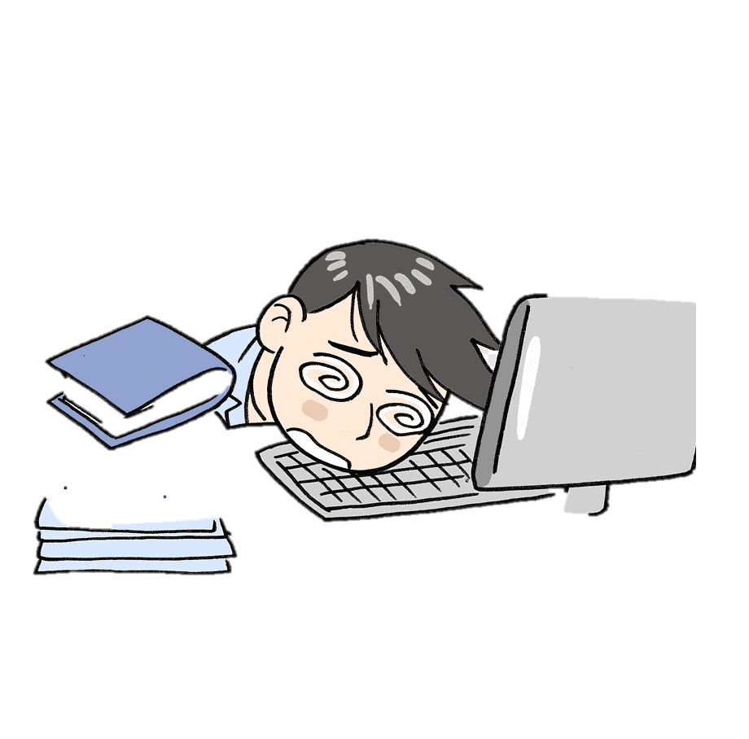

STRENGTHS
WEAKNESS
confidence
Communication skills
Team management
coding
curiosity
Fear of public speaking
patience
A positive attitude

Slide 8

OPPORTUNITIES
parents
faculty
lpu
skills
participation

Slide 9

THREATS
competition
shy
introvert

Slide 10

THANK YOU

